Slide 1
Module 4:
Chart
Analysis
& Repair
Jeffrey Sirard ​
Utica University ​
DSC-563: Data Visualation​
Professor McCarthy​
November 13th, 2026​
Notes:
1. Introduction
Hello and welcome! My name is Jeff Sirard and this is my Module 4 presentation.
Today, we’ll be examining regional adult obesity prevalence and its comorbidity relationships across the United States.
To do so, I’ll be using the 2023 CDC PLACES county dataset.
Module 04: Chart Analysis & Repair
Relevant Links:
Collab URL: https://colab.research.google.com/drive/1bmKgFBiojkP8T30XcCcNvGV3XvvbYhUb?usp=sharing​
GitHub Repository URL: https://github.com/jasirard/DSC563_M03
GitHub Profile URL: https://github.com/jasirard
GitHub Commit URL/ID: See READ.me on Github
Tableau Evidence URL: https://public.tableau.com/views/sirard_jeffrey_CDC_data_Tableau_FINAL/Comparison?:language=en-US&:sid=&:redirect=auth&:display_count=n&:origin=viz_share_link
Target Audience: CDC High Obesity Program (HOP) Directors
Dataset Summary:
i. Basic Information:
Title: CDC PLACES 2023 County Data
Columns: 22
Rows: 229,298
Units: Percentage (%)
ii. Assessment/Handling of Null Values:
LocationName is NULL on the national "US" summary row (LocationID = "59").
Data_Value_Footnote_Symbol and Data_Value_Footnote are NULL on standard county rows and populated only where estimates are suppressed or based on partial state reporting
All calculated fields exclude missing values using NOT ISNULL([Data_Value]) and NOT ISNULL([LocationID]).
iii. Data Preparation, Calculations, and Filters:
Excluded National Summary Row ([StateAbbr] != "US"): Prevents the U.S. total row from double-counting population or skewing county/state averages.
Isolated Prevalence Type ([DataValueTypeID] = "CrdPrv"): Separates crude prevalence from age-adjusted prevalence (AgeAdjPrv) so the two are never averaged together.
Deduplicated Population Denominator: Weighted rates multiply [Data_Value] * [TotalPop18plus] strictly within a single MeasureId and DataValueTypeID so TotalPop18plus is counted once per county rather than ~70+ times (i.e., dataset is long-form structure)
Urbanicity Classification: Categorized counties by TotalPopulation into Rural (<50k), Suburban (50k–250k), and Urban (>250k)

Slide 2
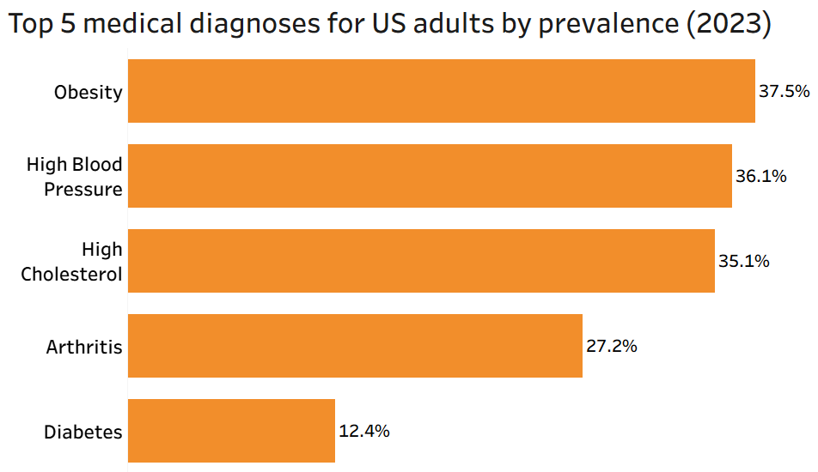
Background
Audience: CDC’s High Obesity Program (HOP) Leadership Team
Question 1: How does adult obesity prevalence vary across U.S. states, and
Question 2: How strongly does this track with other prevalent comorbidities?
(Berengueres, 2019; CDC, 2026)
Notes:
Background
This analysis is designed for the CDC’s High Obesity Program (HOP) leadership
The goal is to answer two questions:
How does adult obesity prevalence vary across U.S. states, and
How strongly does this track with other prevalent comorbidities?
I used the 2023 CDC PLACES County dataset, which contains 22 columns in a long-format structure where each of the roughly 3,144 U.S. counties repeats across multiple health measures.
For accuracy and integrity, I applied three preparation filters:
First, I excluded the national summary row where State Abbreviation equals 'US' to avoid double-counting population.
Next, I isolated crude prevalence percentages for adults 18 and older.
Then, I guarded against null values.
Finally, I verified visualizations using Tableau crosstabs.
Slide References:
Berengueres, J. (2019). Introduction to data visualization & storytelling: A guide for the data scientist (2nd ed., p. 47).
Centers for Disease Control and Prevention (CDC). (2026). PLACES: Local Data for Better Health, County Data 2023 release [Dataset]. U.S. Department of Health and Human Services. https://data.cdc.gov/500-Cities-Places/PLACES-Local-Data-for-Better-Health-County-Data-20/h3ej-a9ec/about_data
(Berengueres, 2019; CDC, 2026)

Slide 3
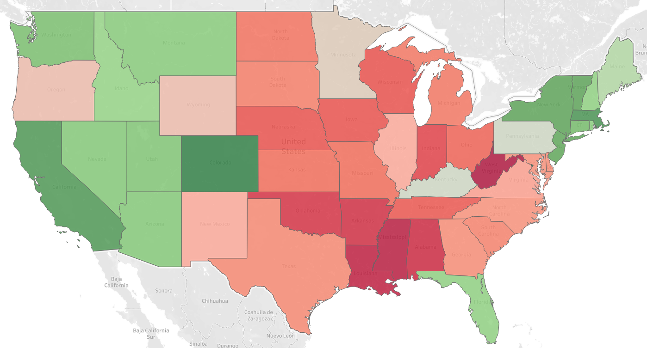
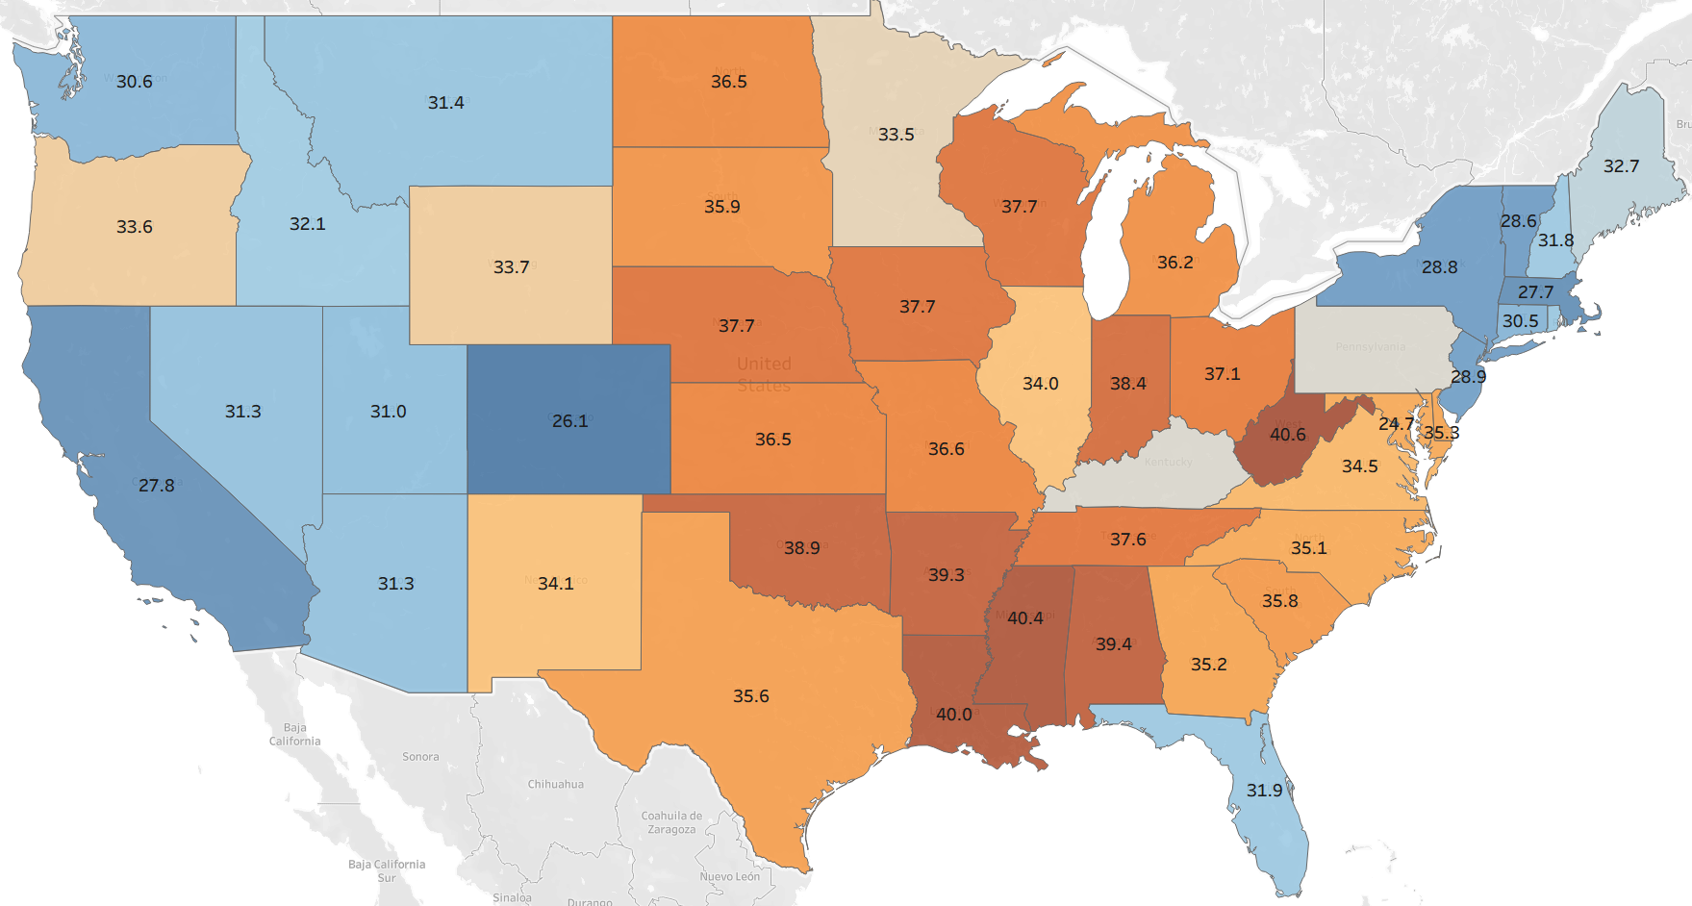
Before/After: Map
(Wilke, 2019)
Notes:
Before/After: Map
My first visual repair addresses accessibility and measure accuracy on the U.S. obesity map.
On the left, my original map used a default red-to-green palette centered on an unweighted state average.
Drawing on Claus Wilke’s Fundamentals of Data Visualization, Chapter 19, I switched to a colorblind-safe orange-blue diverging palette.
Additionally, I added redundancy through direct text labels for state abbreviations and percentages, so color is never the sole carrier of meaning.
Then, as an intentional measure change, I weighted county rates by adult population.
I verified these results using a Tableau crosstab, confirming that West Virginia had the highest weighted adult obesity prevalence at [X.X%], compared to Colorodo at the lowest, [Y.Y%].
Slide References:
Wilke, C. O. (2019). Fundamentals of data visualization (Chapter 19: Common pitfalls of color use). O'Reilly Media. https://clauswilke.com/dataviz/color-pitfalls.html
(Wilke, 2019)

Slide 4
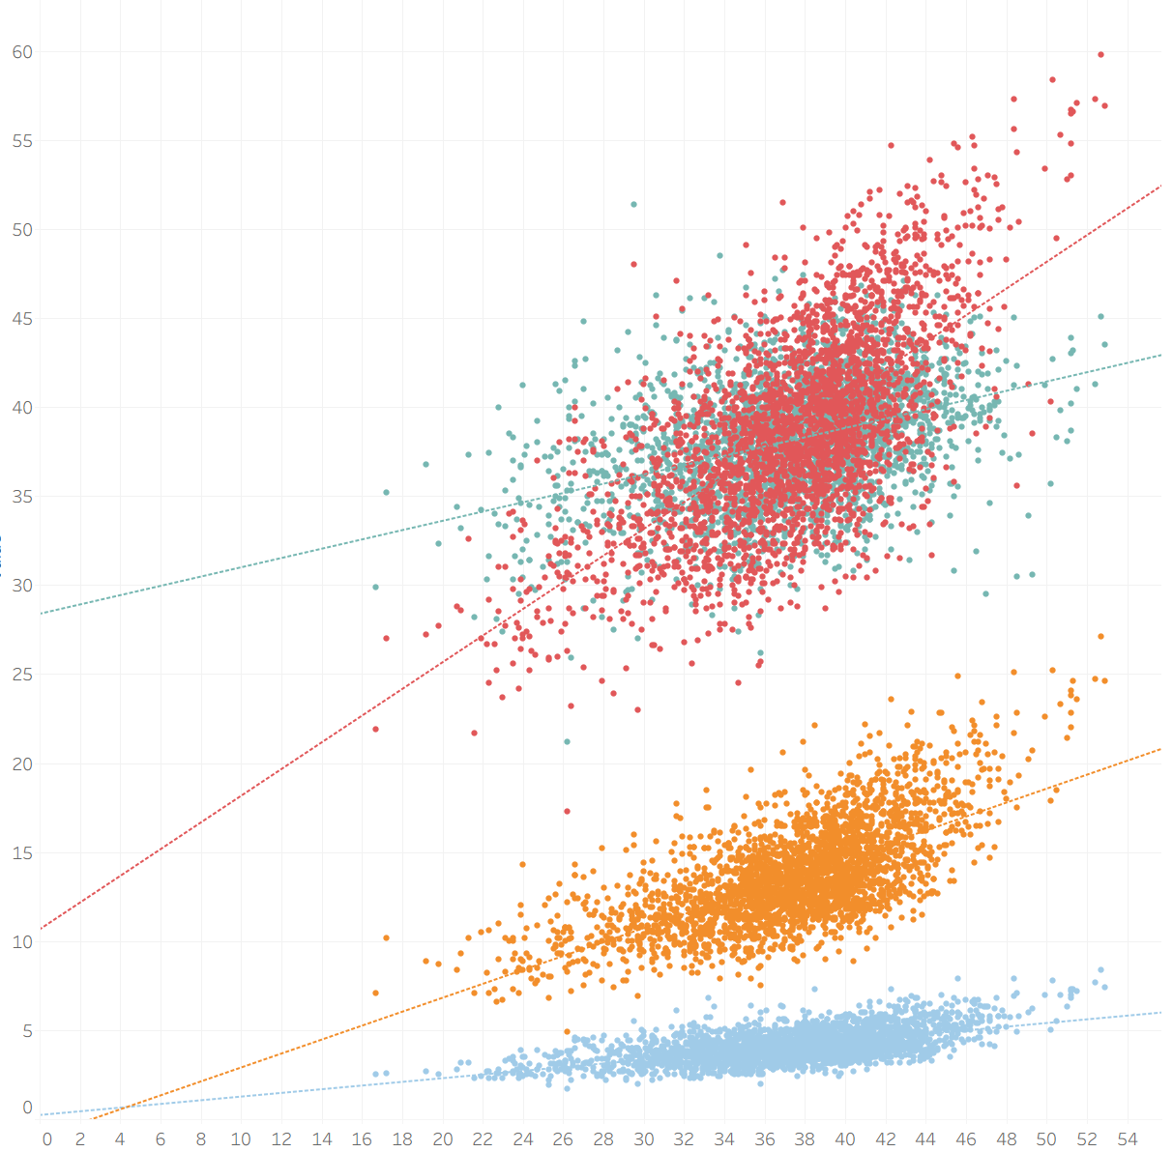
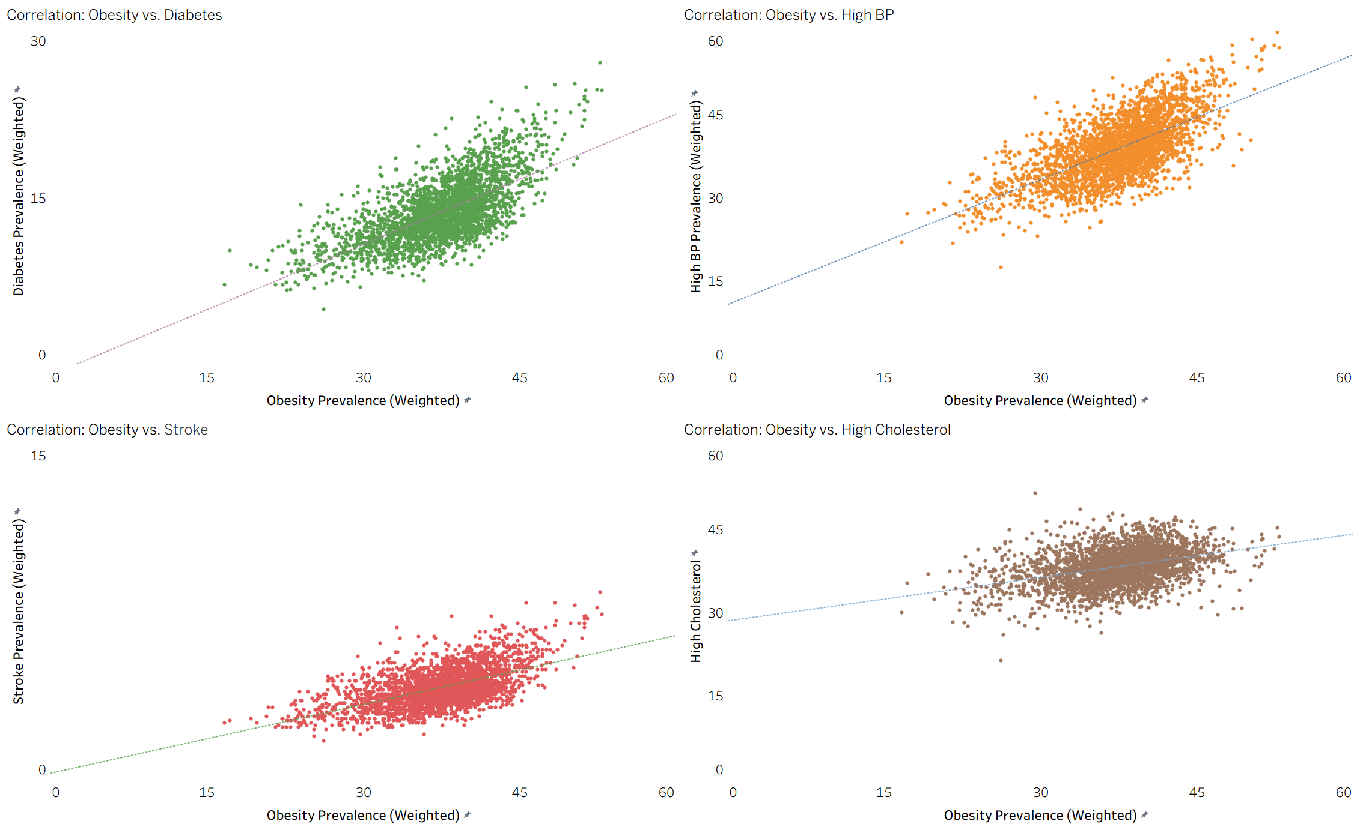
Before/After: Scatter Plots
(Knalfic, 2016; Tufte, 2001)
Notes:
Before/After: Scatter Plots
My second repair addresses visual clutter in my comorbidity relationship view.
On the left, I overlaid four separate chronic conditions (diabetes, high blood pressure, high cholesterol, and stroke) onto a single scatterplot against adult obesity.
The overlapping points and four-color legend created heavy visual noise that masked individual trends.
Applying Cole Nussbaumer Knaflic’s decluttering principles and Edward Tufte’s data-ink ratio from Chapter 2, I redesigned this into a 2-by-2 small multiples grid.
Each condition now occupies its own clean panel with muted gridlines and consistent axes.
Cross-checking the Tableau crosstab confirms that counties in the highest obesity tier, such as [Example County or Rural Tier %], demonstrates consistent adult diabetes prevalence at [Z.Z%].
This makes the positive correlation immediately readable.
Slide References:
Knaflic, C. N. (2016, March 1). Declutter your data visualizations. Storytelling with Data. https://www.storytellingwithdata.com/blog/2016/3/1/declutter-your-data-visualizations
Knaflic, C. N. [Storytelling with Data]. (2015, October 1). Declutter your data visualizations [Video]. YouTube. https://www.youtube.com/watch?v=AiD6etOB6qI
Tufte, E. R. (2001). The visual display of quantitative information (2nd ed., Chapters 2–4). Graphics Press.
(Knalfic, 2016; Tufte, 2001)

Slide 5
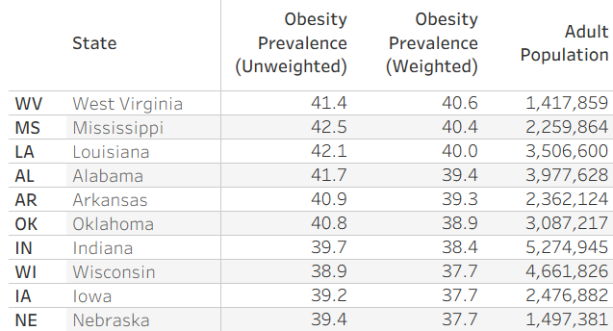
Consequential Comparison
Analytical Trap:
Unweighted county mean vs. adult population-weighting
Practicality:
Considering the denominator shifts funding towards actual high-burden popualtions
Data Limitation:
Estimates are model-based from self-reported BRFSS survey data (i.e., not direct clinical measurements
(Lundeen et al., 2018)
Notes:
Consequential Comparison
For my consequential analytical comparison, I’ve chosen to discuss calculating state and national obesity using an unweighted county mean versus an adult-population-weighted rate.
Because rural counties have much smaller populations than urban metros, an unweighted mean treats a county of 2,000 adults equally with a 7 million adult county, such as Los Angeles county.
We can see differences among the top 10 states for obesity prevalence.
The resulting mean aggregation inflates the national benchmark as well.
This shift changes our conclusion; States with large metro populations drop noticeably once weighted.
In a practical sense, this adjustment rightfully shifts funding priority toward truly high-burden populations.
Supporting research by Lundeen et al. (2018) confirms higher obesity prevalence in nonmetropolitan counties.
One key limitation of CDC PLACES is that estimates are model-based from self-reported BRFSS survey data rather than direct clinical measurements.
Slide References:
Lundeen, E. A., Park, S., Pan, L., O'Toole, T., Matthews, K., & Blanck, H. M. (2018). Obesity prevalence among adults living in metropolitan and nonmetropolitan counties — United States, 2016. MMWR Morbidity and Mortality Weekly Report, 67(23), 653–658. https://doi.org/10.15585/mmwr.mm6723a1
(Lundeen et al., 2018)

Slide 6
References
Dataset:
Centers for Disease Control and Prevention (CDC). (2026). PLACES: Local Data for Better Health, County Data 2023 release [Dataset]. U.S. Department of Health and Human Services. https://data.cdc.gov/500-Cities-Places/PLACES-Local-Data-for-Better-Health-County-Data-20/h3ej-a9ec/about_data
Required:
Berengueres, J. (2019). Introduction to data visualization & storytelling: A guide for the data scientist (2nd ed., p. 47).
Knaflic, C. N. (2016, March 1). Declutter your data visualizations. Storytelling with Data. https://www.storytellingwithdata.com/blog/2016/3/1/declutter-your-data-visualizations
Knaflic, C. N. [Storytelling with Data]. (2015, October 1). Declutter your data visualizations [Video]. YouTube. https://www.youtube.com/watch?v=AiD6etOB6qI
Tufte, E. R. (2001). The visual display of quantitative information (2nd ed., Chapters 2–4). Graphics Press.
Wilke, C. O. (2019). Fundamentals of data visualization (Chapter 19: Common pitfalls of color use). O'Reilly Media. https://clauswilke.com/dataviz/color-pitfalls.html
External:
Lundeen, E. A., Park, S., Pan, L., O'Toole, T., Matthews, K., & Blanck, H. M. (2018). Obesity prevalence among adults living in metropolitan and nonmetropolitan counties — United States, 2016. MMWR Morbidity and Mortality Weekly Report, 67(23), 653–658. https://doi.org/10.15585/mmwr.mm6723a1
AI Disclosure:​
Grammarly was used to assist in writing the script.​​
PowerPoint Designer was used to assist with slide visuals.​​
Notes:
References
That’s all for now.
Here are my references and AI disclosure.
Thank you!

